Slide 1
Analysis of Recycling trends in New York city
Group DC20078

Slide 2
Introduction

Slide 3
Agenda

Slide 4
Problem Statement
What type of recycling is most common in different areas and what areas should be targeted for increased recycling efforts and education?

Slide 5
Data

Slide 6
Assumptions
The promotion of recycling over time remains constant

Slide 7
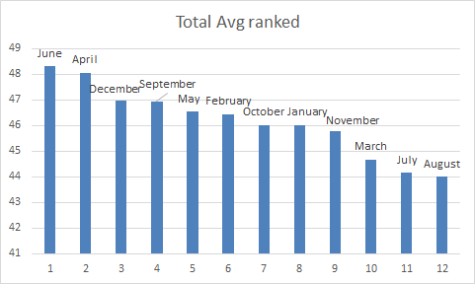
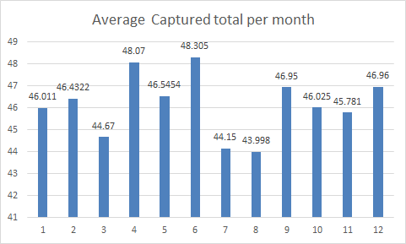
Recycling by month
People recycle most in June and least
In August

Slide 8
Predictive Analysis
June
The end of school
July, August
Vacation, collecting supplies for school rather than throwing it away

Slide 9
Legend
Y-Axis:
Average in Percentage
X-Axis:
Districts
Districts:
MN(#) = Mahattan, District number
BX = Bronx
QW = Queens West
QE Queens East
BKN = Brooklyn North
BKS = Brooklyn South
SI = Staten Island

Slide 10
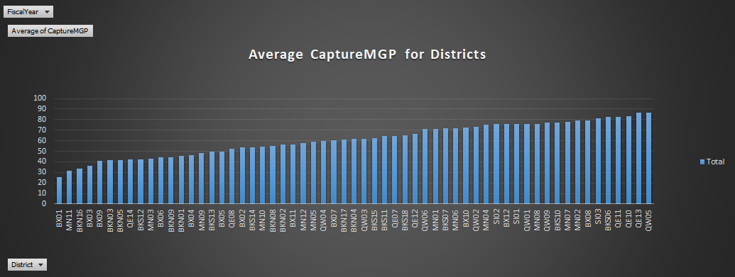

Slide 11
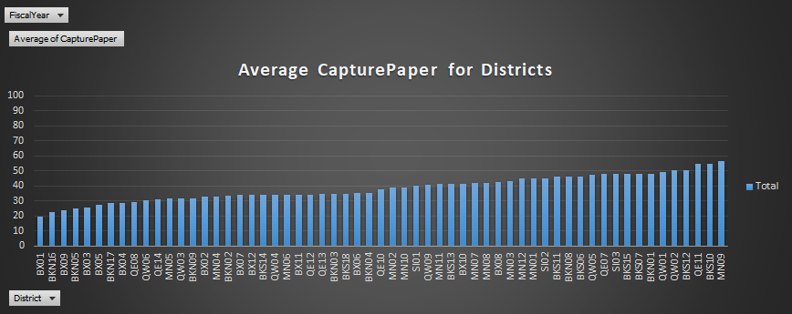

Slide 12
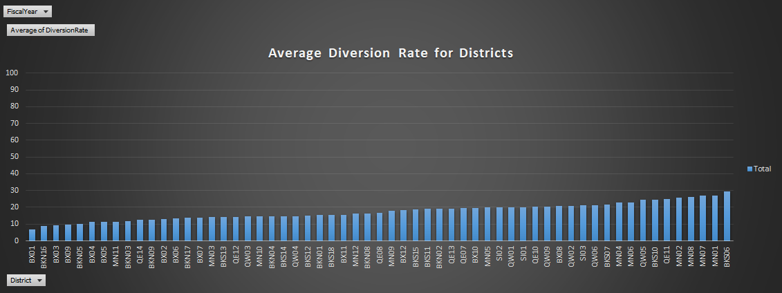

Slide 13
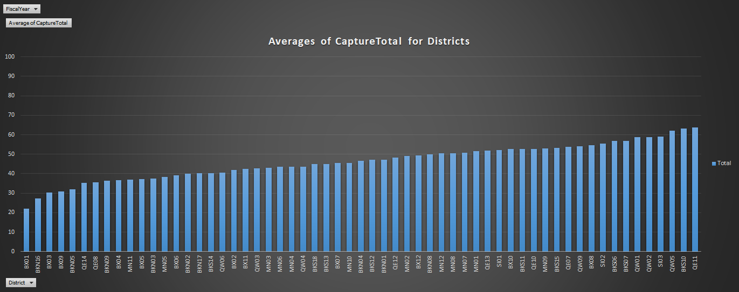

Slide 14
Recycling by district
District MN09 recycles the most paper
District QW05 recycles the most MGP
District BX01 recycles the least of both

Slide 15
Predictive Analysis
Manhattan: Huge population, business area
Queens West:
Bronx:

Slide 16
Recycling by type
MGP is collected on average much
Higher than paper

Slide 17
Conclusions and steps going forward
Our predictive analysis and graphics allowed us to find trends and identify areas of concentration for education and improved recycling efforts.

